Slide 1
DRIVER DROWSINESS DETECTION SYSTEM
Project Number: 9
Team Members:
Kumsetty Nikhil Venkat (181IT224)
Ayush Rahangdale (181IT109)
Ankit Gupta (181IT107)

Slide 2
Introduction
Drowsiness is the state of feeling tired or sleepy.
Driver fatigue affects the driving ability of many drivers in the following 3 ways:
It impairs coordination,
It causes longer reaction times and delays the reflex action.
It impairs judgment .
The driver safety in the car is one of the most wanted system to avoid accidents.
Driver Drowsiness Detection System is one of the driver safety system.

Slide 3
Objective
The objective of the project is to make an efficient system to detect the drowsiness state of the driver and sound alarm to prevent accidents.
To alert the vehicles behind with the help of LCD display.

Slide 4
Requirements Analysis
Hardware Requirements
Laptop
Male to male wires
Bread-board
Arduino
Connecting cable
LCD display
Potentiameter
Software Requirements
Arduino IDE 1.8.10
Python IDE

Slide 5
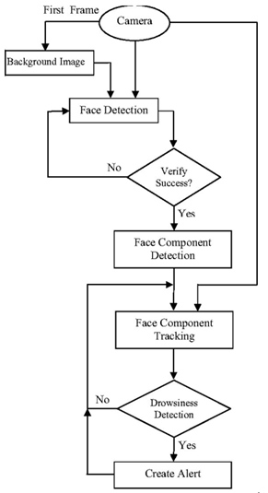
Methodology
The algorithm detects the face in the pre-processed image by using facial landmarks produced by Dlib library.
In the detected face region, the algorithm finds the face landmark
To detect eye region, the correct array slices from the set of face landmarks is detected.
Set the EAR threshold = 0.25.
Calculate EAR (eye aspect ratio) to determine whether the eyes of the driver are closed or not while driving.
Check to see if the eye aspect ratio is below the “blink/closed” eye threshold.
If it is, increment COUNTER, the total number of consecutive frames where the person has had their eyes closed.
If the counter is greater than 50, alarm sounds and “ALERT!” is displayed in the LCD.
Fig. 1: Flow chart for driver drowsiness detection system

Slide 6
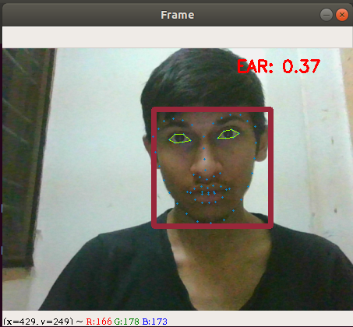
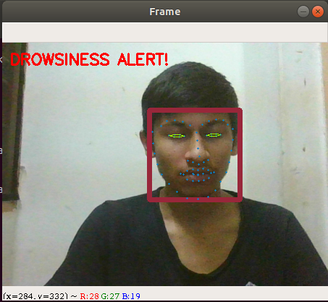
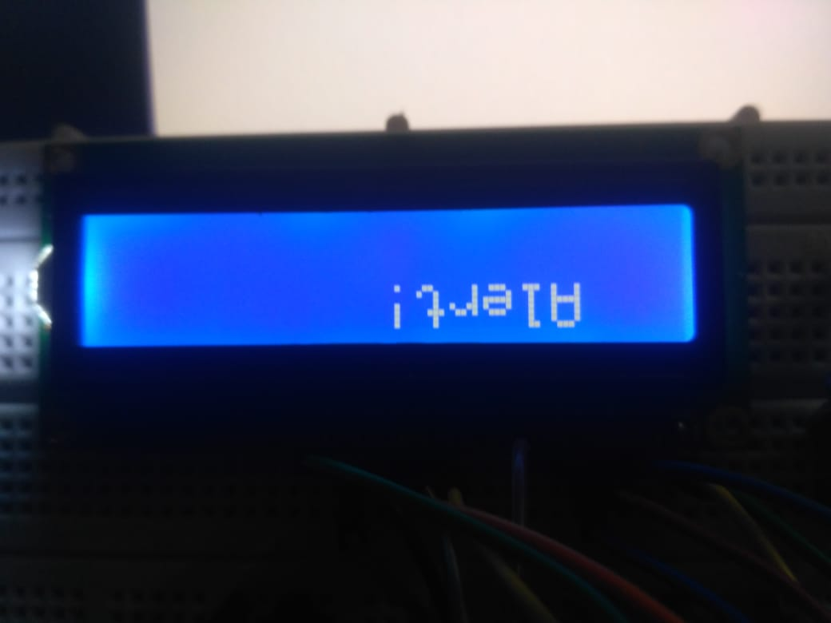
Output
Fig 4: Alert message
Fig 2: Active State
Fig 3: Drowsy State

Slide 7
Result and Analysis
Input No. | Total Experimental Blinks | True Detection | False Detection | Missed Detection | Accuracy
1 | 10 | 3 | 0 | 0 | 100%
2 | 8 | 4 | 0 | 0 | 100%
3 | 12 | 2 | 0 | 0 | 100%
4 | 15 | 5 | 0 | 0 | 100%
5 | 27 | 10 | 0 | 1 | 91%
6 | 9 | 3 | 0 | 0 | 100%
7 | 17 | 6 | 0 | 0 | 100%

Slide 8
Individual contribution
Ankit Gupta 181IT107
Implementing facial detection and developing a python program using PySerial module to link Arduino with python.
Ayush Rahangdale 181IT109
Implementing facial landmark detection and developing a function for eye detection.
Kumshetty Nikhil Venkat 181IT224
Implementing the EAR algorithm and developing a function to compute EAR ratio and check with EAR threshold.

Slide 9
Conclusion
The system will overcome the drawbacks by providing accurate and reliable results after analyzing the condition of a driver while driving.
The system can be used in wide range of locomotives such as trucks, cars, aero planes.
In future, this system can be developed into an inbuilt system by vehicle manufacturers and installing an infrared camera, high resolution speakers and a high definition LCD display.

Slide 10
Thank You

